Slide 1
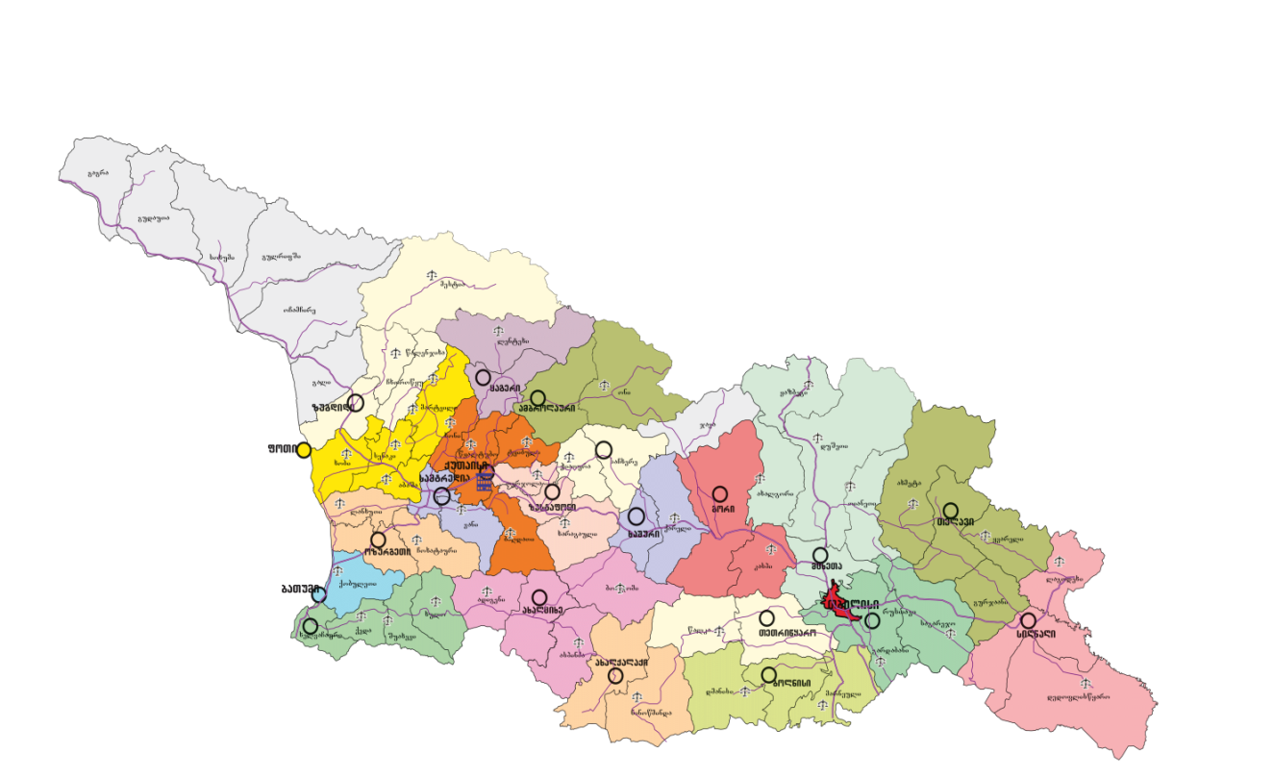



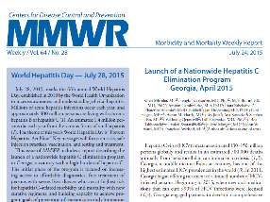
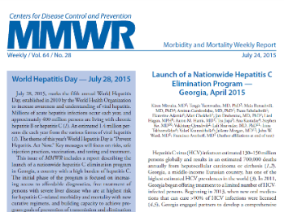
Hepatitis C elimination program in Georgia
David Sergeenko¹, Valeri Kvaratskhelia¹, Amiran Gamkrelidze², Irina Tskhomelidze¹, Davit Baliashvili², Maia Tsereteli², Tengiz Tsertsvadze³, Lia Gvinjilia⁴, Juliette Morgan⁵, Muazzam Nasrullah⁶, Maia Butsashvili⁷, Lali Sharvadze⁸, David Metreveli⁹, Francisco Averhoff⁶
Contact Information:
Background
Why Georgia?
Georgia, a country in the Caucasus region of Eurasia, considering serosurvey data (performed with technical support of US CDC) has a high prevalence of hepatitis C virus (HCV) infection.
Features that made Georgia an ideal setting for eliminating HCV:
  High prevalence
  Small population
  Political will
  Diagnostic and human capacity
  Close partnership with US CDC and other organizations
Characteristic | n | % | Estimated # nationwide ≥18 years
Anti-HCV+ | 425 | 7.7% | 208,800
HCV RNA+ | 311 | 5.4% | 150,300
Substantial progress has been made to eliminate HCV infection in Georgia, and the country has demonstrated the ability for rapidly scale up of care and treatment services. To achieve elimination, there still some challenges remain, including increasing access to care and treatment services and implementing a comprehensive approach to prevention and control of HCV infection.
Georgia’s HCV elimination program could provide lessons for future programs to control HCV infection worldwide, particularly as treatment becomes more affordable and more countries seek to provide care and treatment services.
In April 2015, Georgia government announced HCV as a priority and committed to eliminate the disease by 2020 and launched the unprecedented Hepatitis C Elimination Program, initially focused on treating HCV-infected persons with severe liver disease using curative regimens based on new direct-acting antivirals (DAAs). Starting in June, 2016, inclusion criteria were removed, expanding enrollment eligibility to include patients regardless of disease stage.
History and Overview of the HCV Elimination Program
2014-2016
2016 (1 Quarter)
Grant for development of new electronic program
First stock of Ledipasvir/Sofobusbuvir
2016
4th National Hepatitis C Elimination Workshop
AASLD Special session
2016 (June)
New “Elimination С” program was launched
Eligibility criteria were removed
2015 (April)
Approval of HCV elimination action plan and Launch of state program
2015 (Nov)
1st TAG
2014
Negotiations with US CDC, Gilead Sciences Inc. and other partners
1st National Workshop on Hepatitis C and Establishment of National Committee for HCV
Treatment with “Sofosbuvir” based regimens
2015 (July)
2015 4th (Quarter)
Assessment of electronic database
“Stop C”
2016 (April)
Side session for Georgia at EASL
Long term agreement between Company Gilead Sciences, In.
2016 (October)
2nd TAG
Establishment of Georgia HCV Elimination Scientific Committee
References
¹ Ministry of Labour, Health and Social Affairs of Georgia
² National Center for Disease Control and Public Health of Georgia
³ Infection Diseases, AIDS, and Clinical Immunology Research Center, Tbilisi, Georgia
⁴ CDC Foundation
⁵ Global Disease Detection, Division of Global Health Protection, South Caucasus CDC Office, Tbilisi, Georgia
⁶ Division of Viral Hepatitis, National Center for HIV/AIDS, Viral Hepatitis, STD and TB Prevention, Centers for Disease Control and Prevention, Atlanta, Georgia, USA
⁷ Clinic “Neolab”, Tbilisi, Georgia
⁸ Clinic “Hepa”, Tbilisi, Georgia
⁹ Clinic “Mrcheveli”, Tbilisi, Georgia
Conflicts of Interests
No conflicts of interest to report.

